Slide 1

CareerConnect Narowal
Final Year Project
Group Members
Project Supervisor
Mr. Zishan Zafar
Project Co-Supervisor
Mr. Waseem Younas
Umair Aslam 20-UON-0573
Muhammad Shameer 20-UON-083
Muhammad Hussain 20-UON-0594

Slide 2
INTRODUCTION
Career Connect Narowal is an innovative online job portal designed to empower job seekers in Narowal by offering free skill-enhancement courses and connecting them with potential employers. Our platform serves as a mediator between job seekers and companies, ensuring a seamless hiring process.

Slide 3
Challenge Faced
Small businesses and startups struggle to find skilled candidates.
01
02
Small businesses and startups struggle to find skilled candidates.
03
Talented students struggling to find suitable employment
04
Lack of accessible skill development resources
High recruitment costs for small and medium-sized businesses

Slide 4
Proposed Solution
Career Connect has the following features
Streamlined hiring process without the need for HR departments
Free skill-enhancing courses for job seekers
Focus on Narowal’s local talent pool

Slide 5
Scope
Enhance the skill set of job seekers in Narowal.
Provide more job opportunities for college and university students.
Promote digital transformation in Narowal.

Slide 6
Purpose:
To provide a seamless platform where job seekers can enhance their skills through free courses and connect with employers for job opportunities, reducing the hassle for companies to find the perfect candidates.

Slide 7
Business Model
Revenue Stream
15-20% Commission on Successful Hires
We earn revenue by charging employers a 10% fee for each successful hire made through our platform.
Cost Structure
Platform Maintenance: Ongoing expenses for server costs, software updates, and technical support.
Course Development: Investment in creating and updating free educational content for job seekers.
Marketing:Funds allocated for digital marketing campaigns, social media advertising, and promotional activities to attract users.

Slide 8
Key feature (Admin)
1
Login
6
Manage Jobs
2
View stats
7
Manage users
3
Admin info
8
View Profile
4
Job Request
5
Applications

Slide 9
Key feature (Employer)
Key feature (Job Seeker)
1
Sign up
7
Enroll Course
1
Sign up
2
Log In
2
Log In
6
Applications
3
Dashboard
3
View Profile
4
Add Job
4
update Profile
5
Manage Job
5
Apply Jobs
6
Update Job

Slide 10
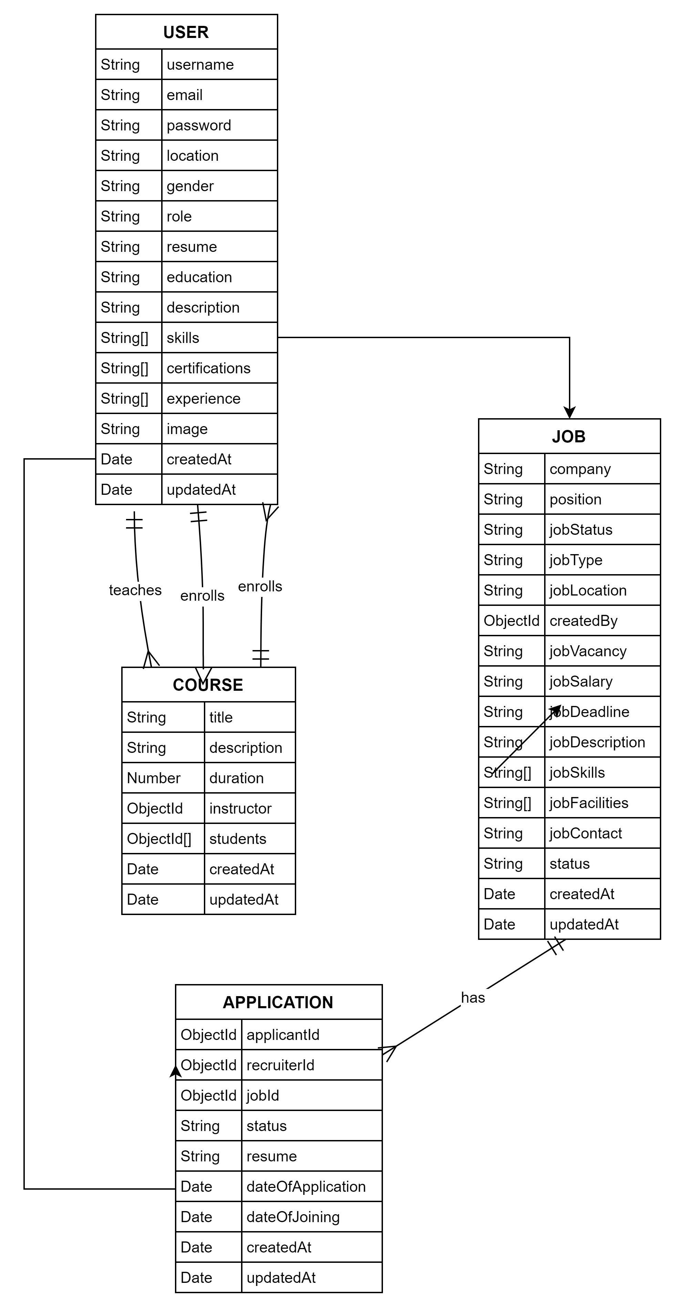
ERD Diagram

Slide 11
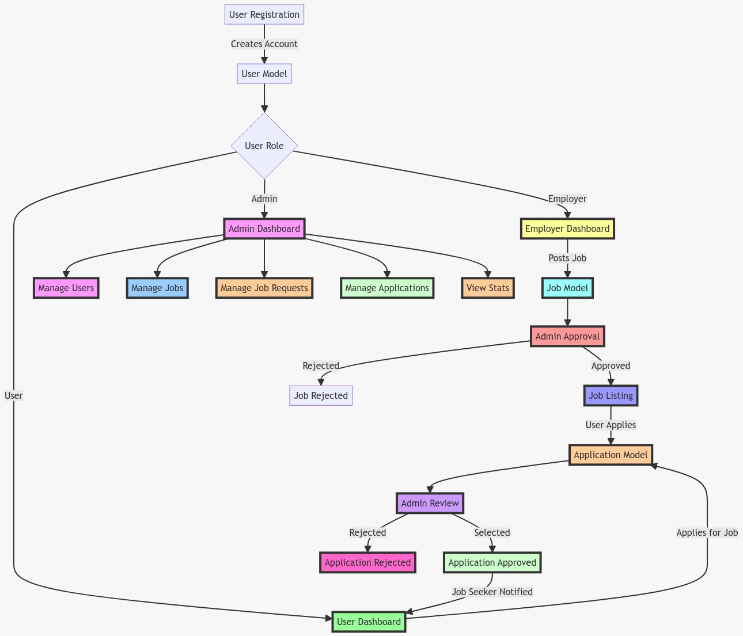
Flow Chart

Slide 12
Design

Slide 13
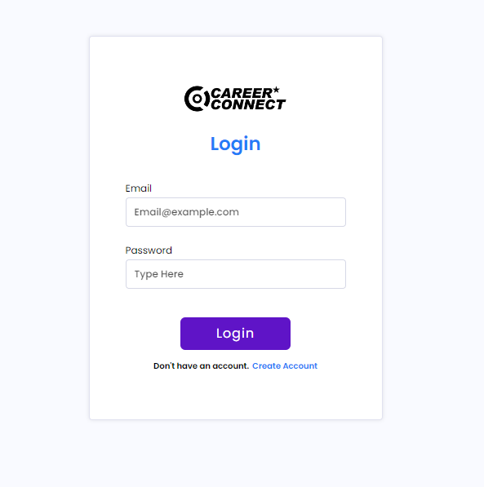
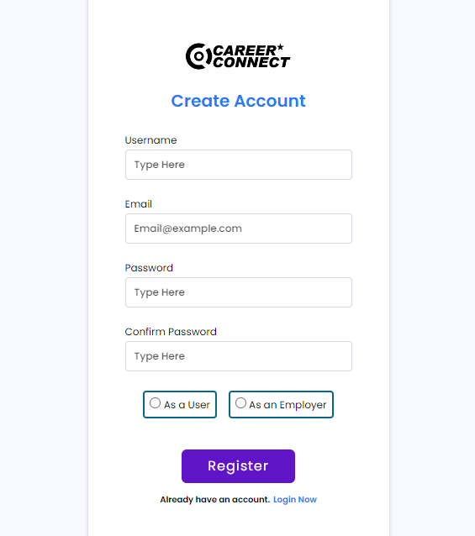
Employer & User Login

Slide 14
Employer & User Login

Slide 15
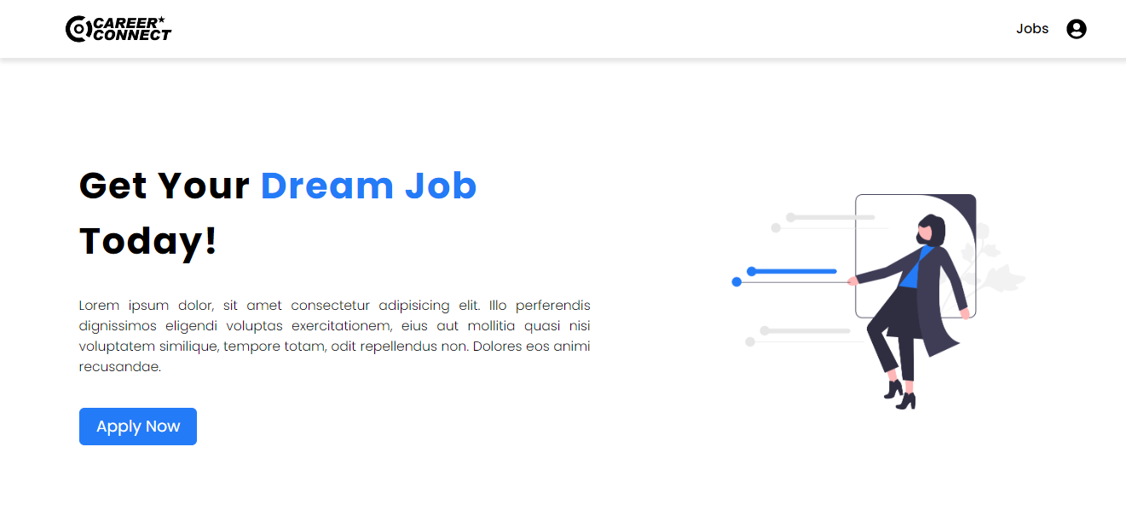
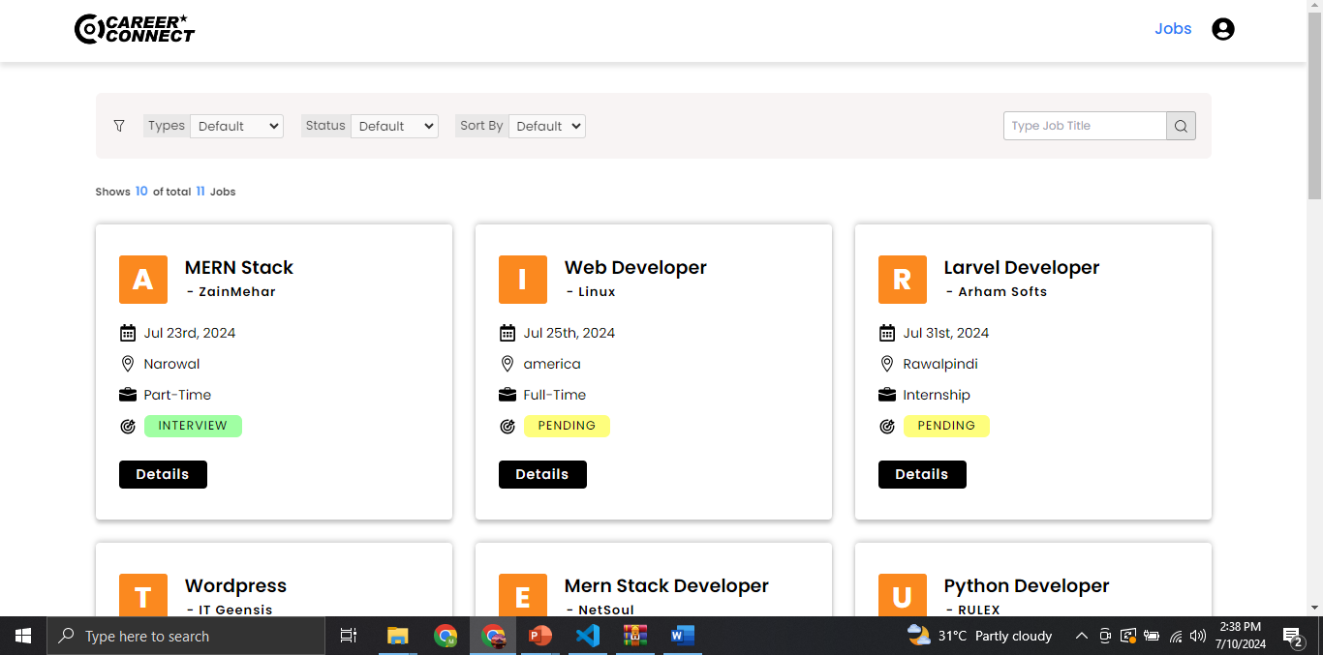
Home Page & Job Page

Slide 16
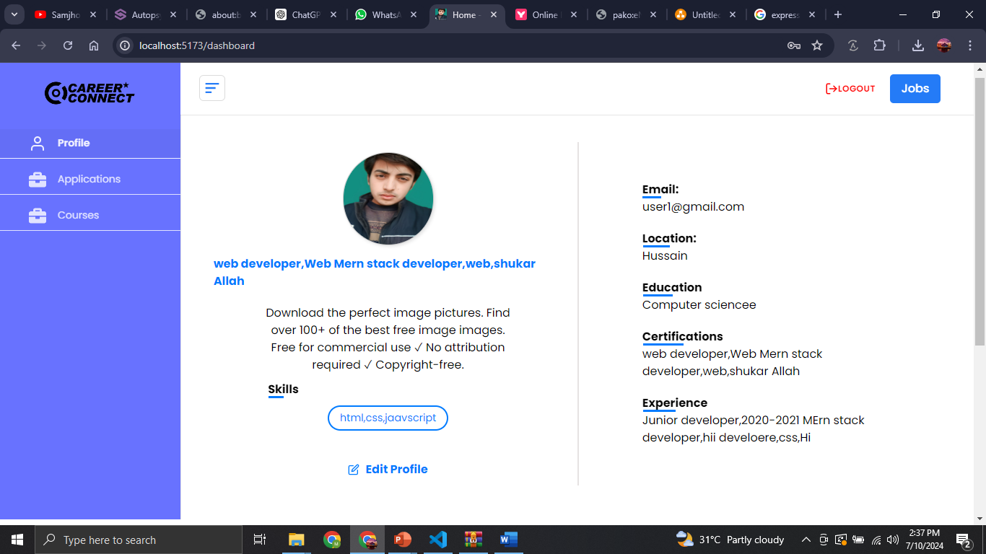
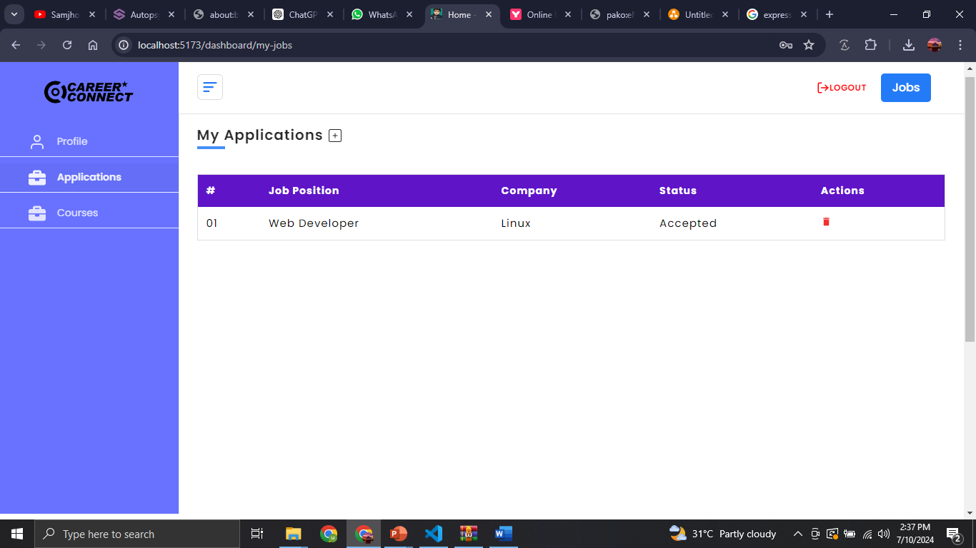
User Profile & Applications

Slide 17
User Profile & Applications

Slide 18
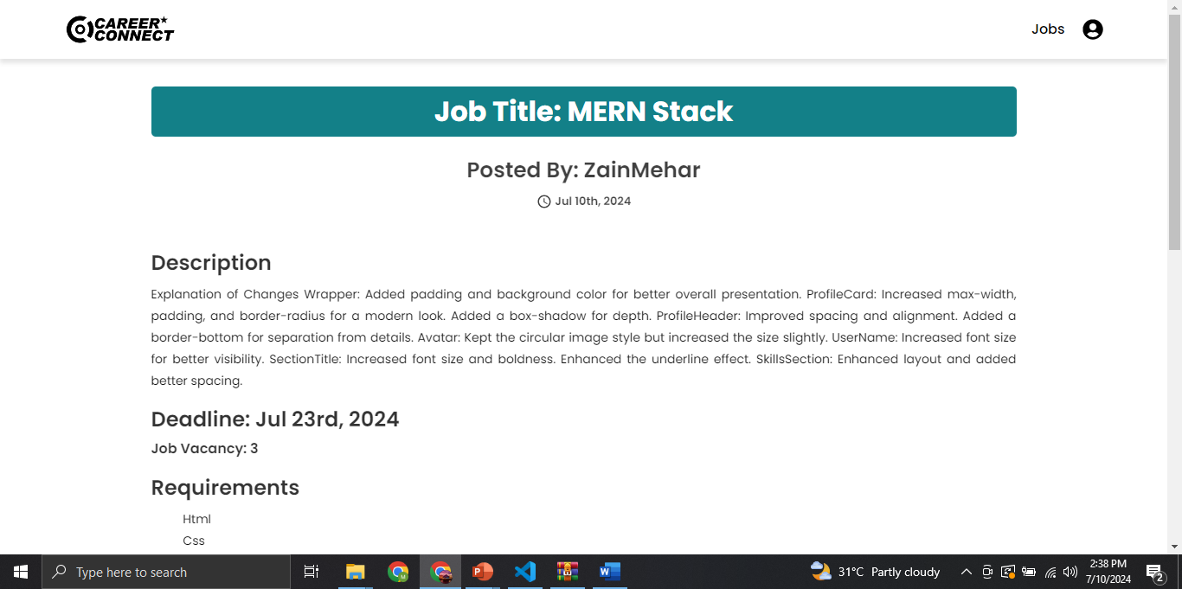
Job Detail Page

Slide 19
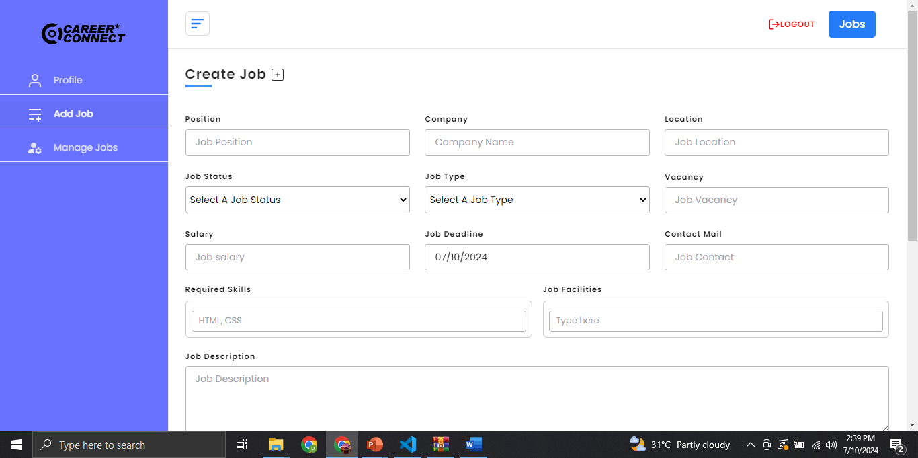
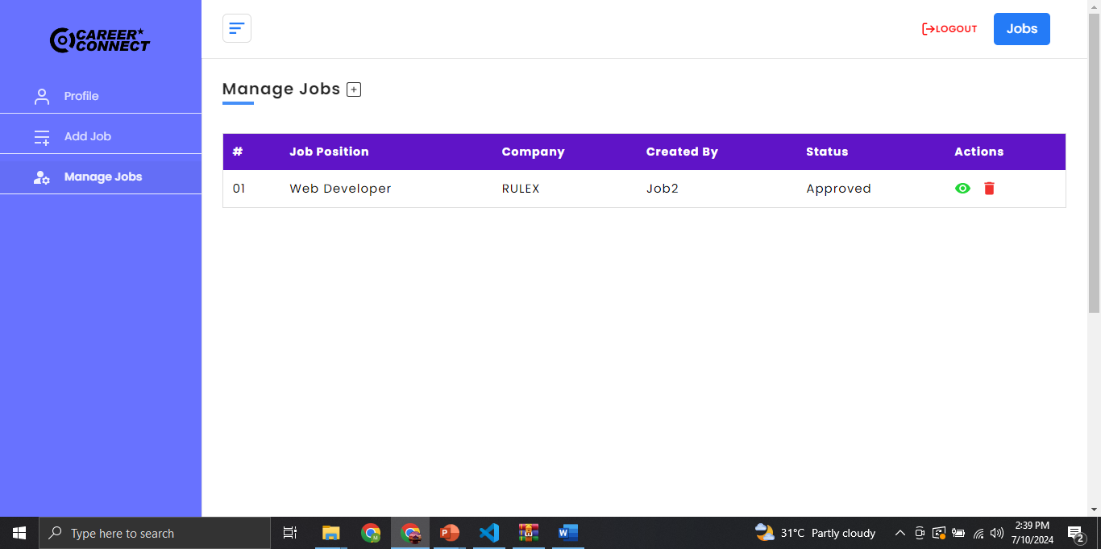
Employer Post & Manage Job Page

Slide 20
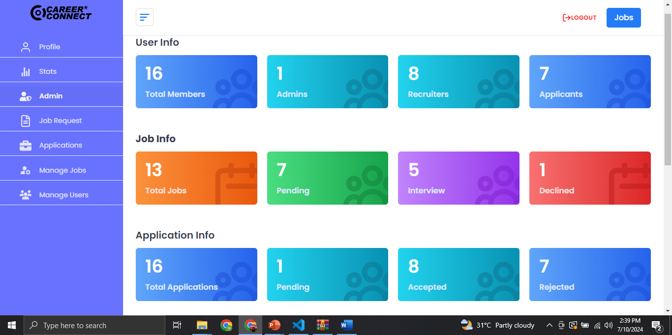
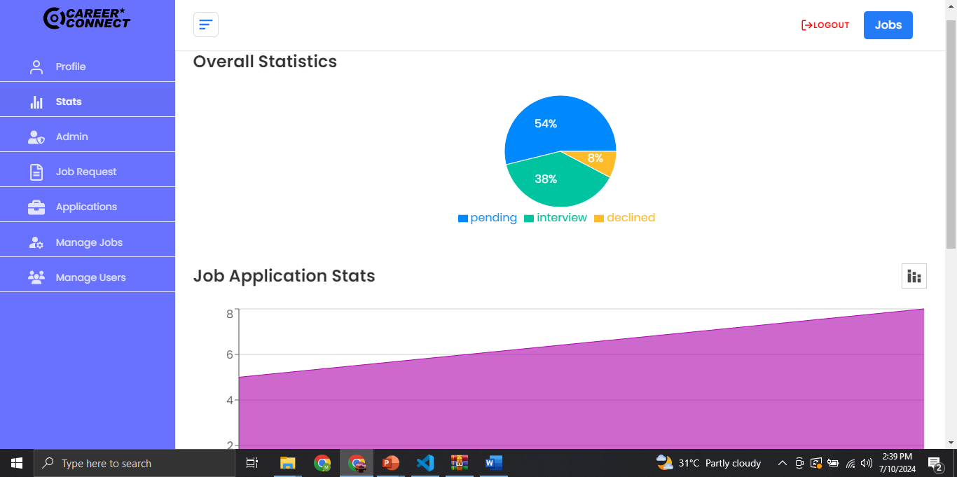
Admin Stats

Slide 21
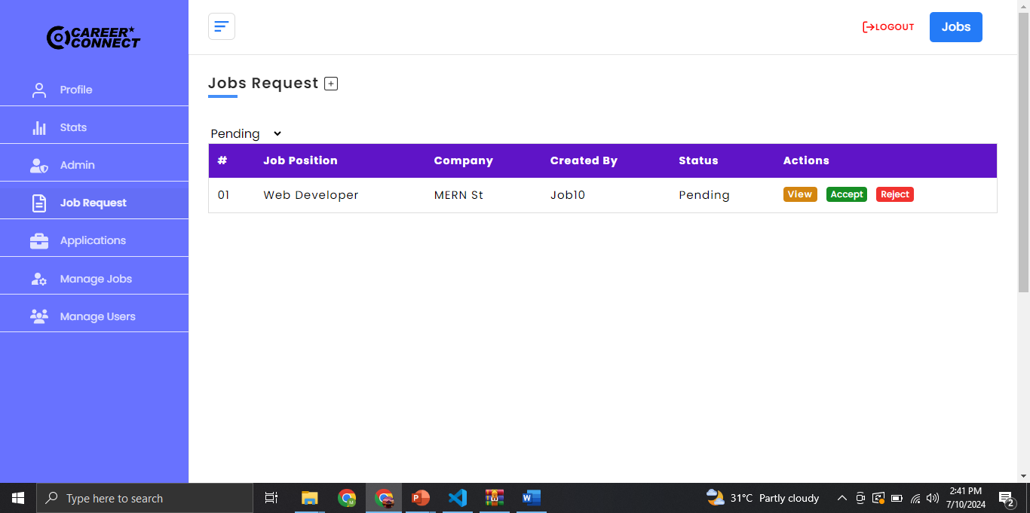
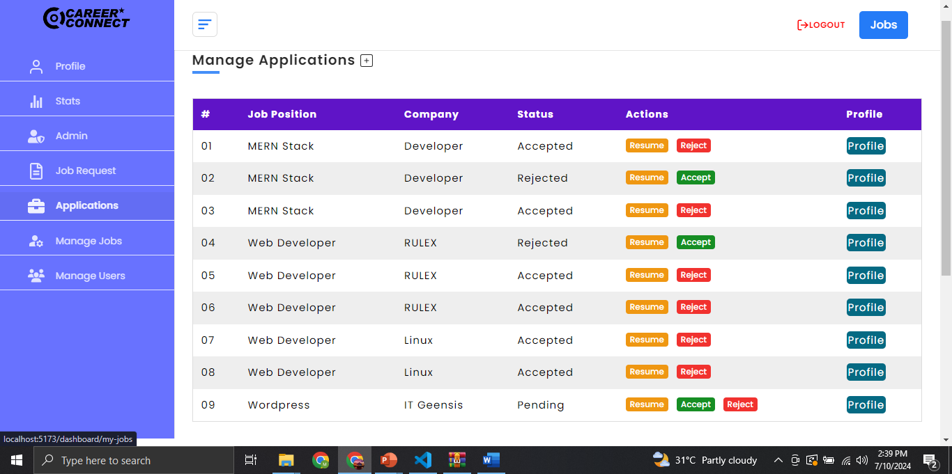
Admin Job Request & Manage Applications page

Slide 22
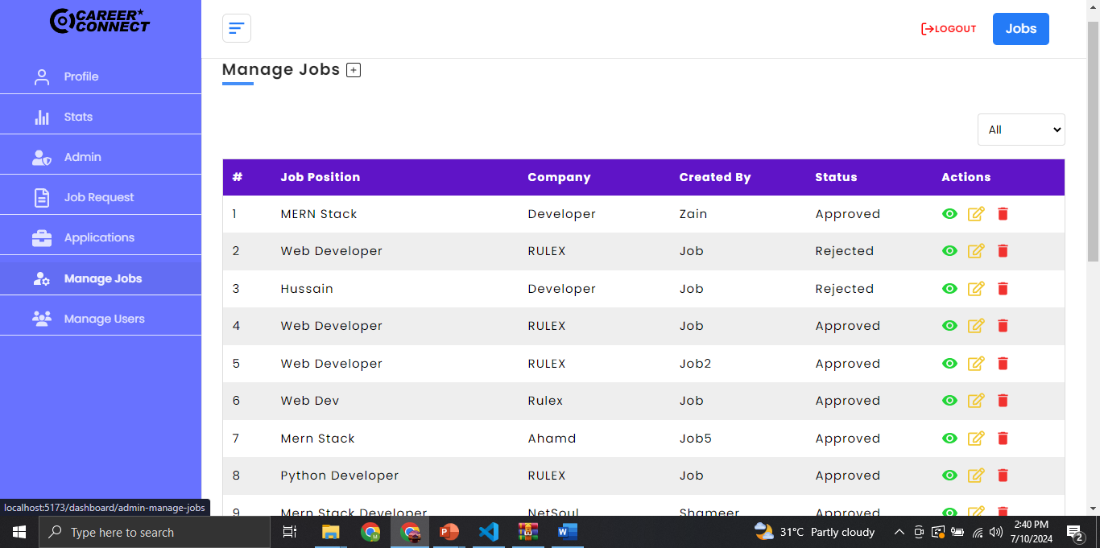
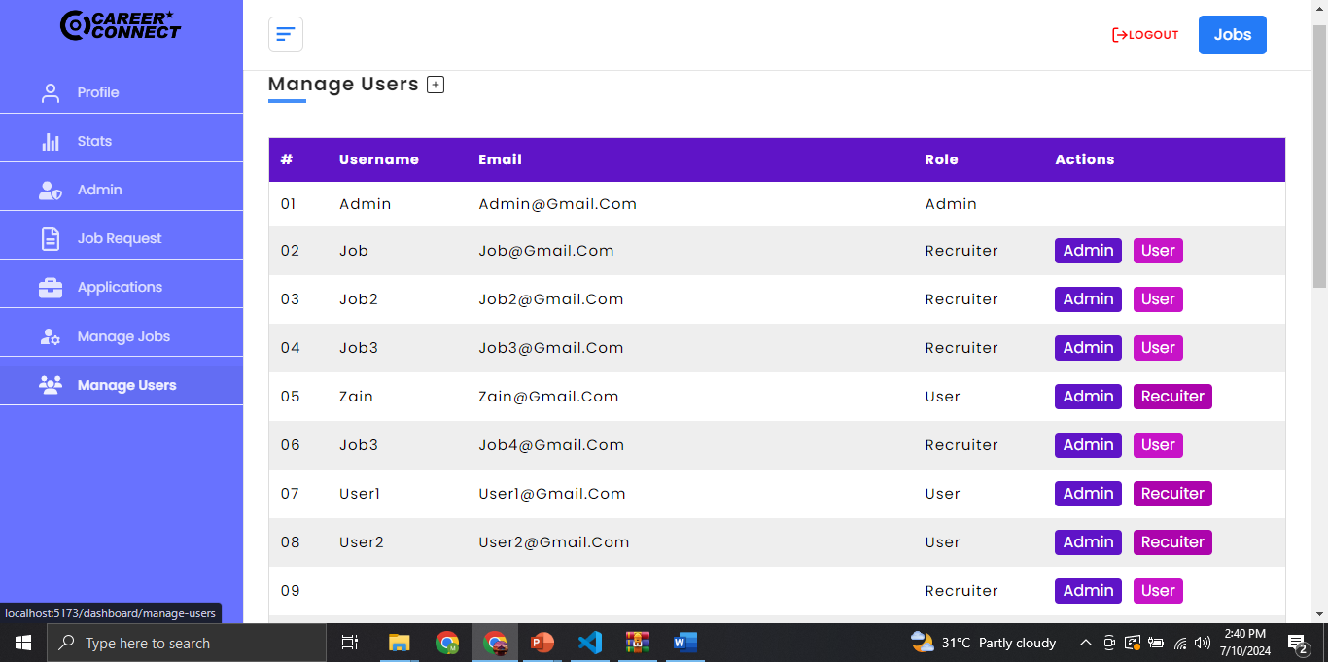
Admin Job Request & Manage Job page

Slide 23
Gantt Chart
Task | Dec- 2023 | Jan- 2024 | Feb- 2023 | Mar- 2024 | April- 2024 | May-2024 | June-2024 | July- 2024
Idea Generation/ Proposal writing
Requirement Gathering/Risk Assessment
Software Architecture Design

Slide 24
Future Enhancement
Payment module
1
Securely process payments for your customers.
2
Rating module
Collect feedback and ratings from your users.
3
Feedback module
Receive valuable feedback from your customers.
Expansion
4
Expansion of Career Connect in neighbouring regions
Available for other OS as well.
5
Supports multiple operating systems for wider accessibility.

Slide 25
CONCLUSION
Career Connect Narowal, an online job portal aimed at enhancing employment opportunities in Narowal. It addresses key challenges such as the difficulty small businesses face in finding skilled candidates, and the lack of accessible skill development resources. The platform offers free skill-enhancement courses, streamlines the hiring process, and focuses on Narowal’s local talent pool. The business model includes a commission on successful hires. Future enhancements involve adding payment, rating, and feedback modules, regional expansion, and support for multiple operating systems. The report highlights the platform's role in promoting digital transformation and presents promising test results.

Slide 26
THANKS!

